Slide 1
Parametric Model Regression
3D Vision Summer School 2025, Day 4

Slide 2
Slides Link: https://tinyurl.com/3dvss-day4ppt
Notebook Link: https://tinyurl.com/smpl-3dvss

Slide 3
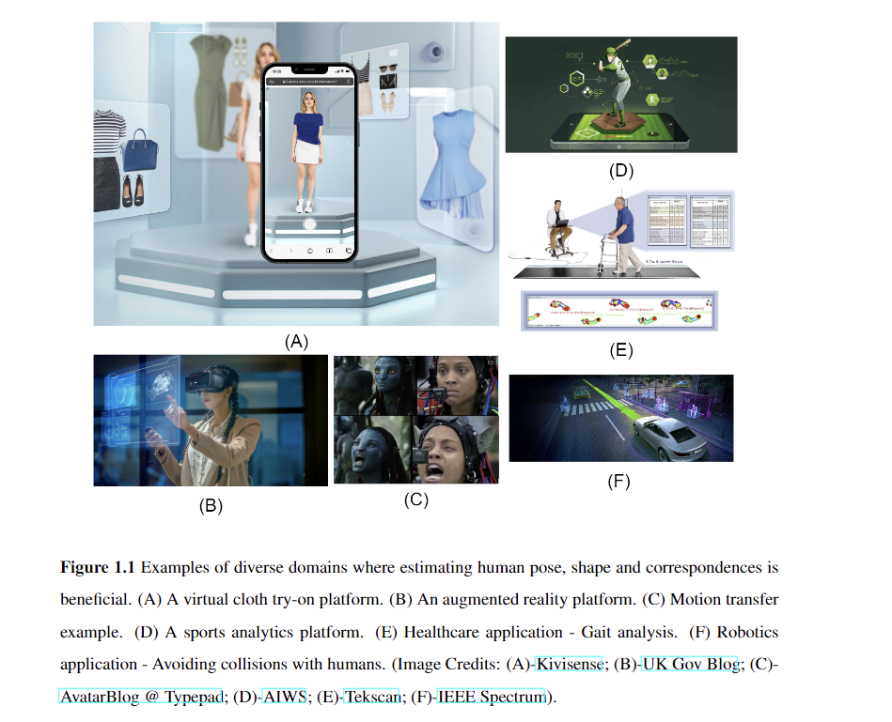
Applications

Slide 4
SMPL 3D Joint Rotations
Each of the 23 joints in SMPL has an associated 3D rotation
3D rotations can be represented in various ways: Euler angle representation, Quaternions, Rotation Matrices. Other representations may exist (Check this blog: https://towardsdatascience.com/better-rotation-representations-for-accurate-pose-estimation-e890a7e1317f )
In SMPL, typically we use a Euler angle representation. It is represented as a 3-tuple or a 3 element list: [angle wrt X, angle wrt Y, angle wrt Z]
Thus, in order to represent the 23 joints, in total we need 23*3 = 69 numbers
Please note that the root joint’s rotation and translation are handled separately

Slide 5
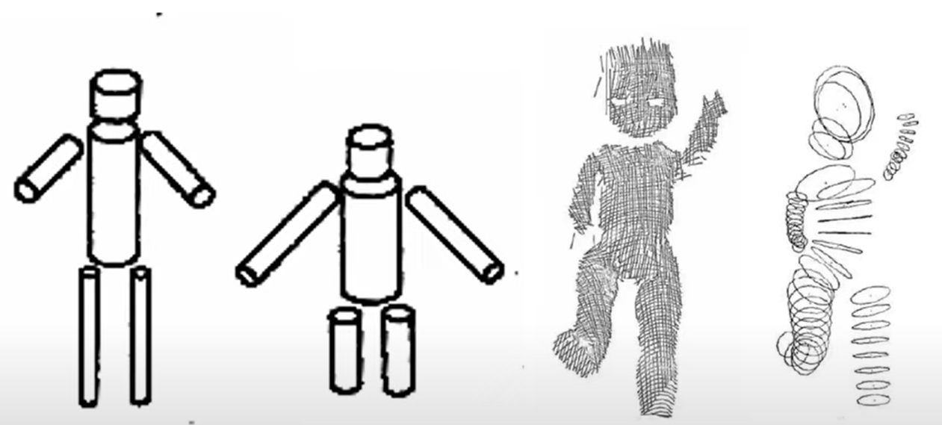
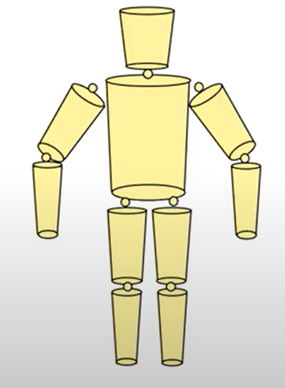
Initial Representation

Slide 6
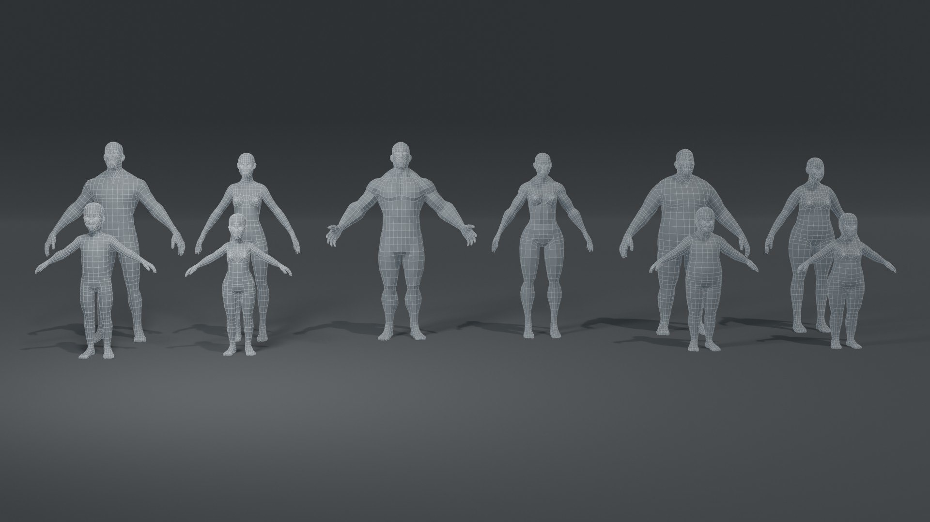
Skinned Multi-Person Linear

Slide 7
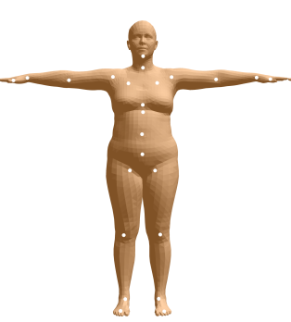
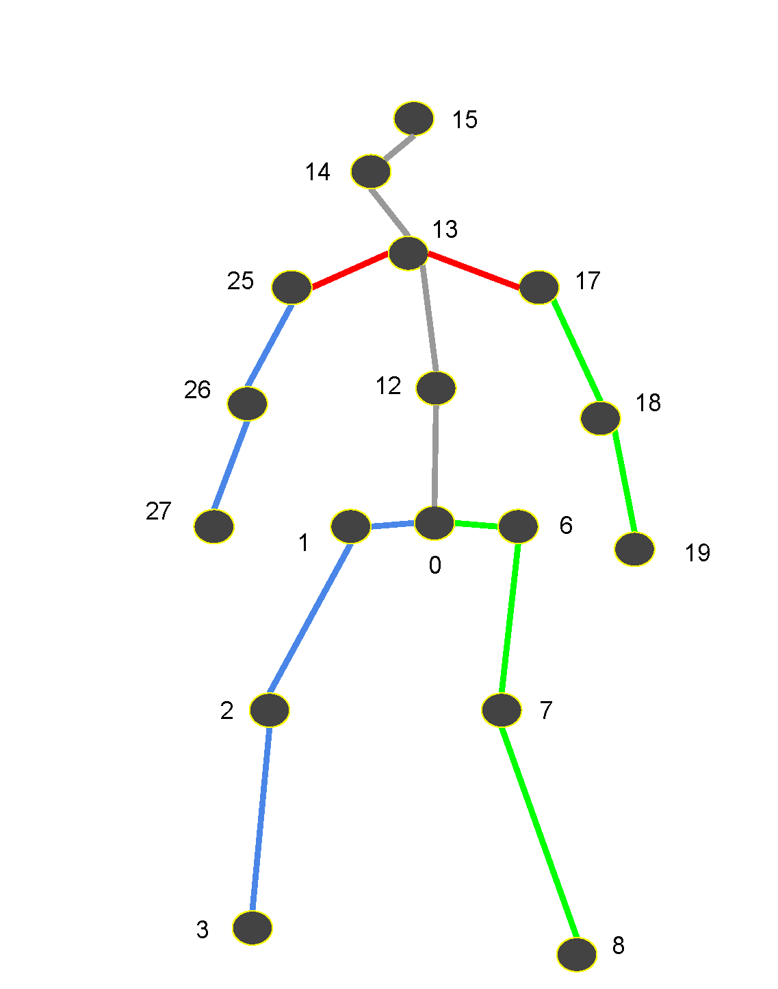
Human Mesh
Each mesh has 6890 vertices
Comprises of 24 joints
Skinning Weights
Represented as triangulated mesh, rotated as per kinematic tree
Divided into Male, Female and neutral

Slide 8
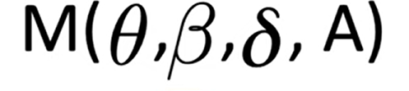
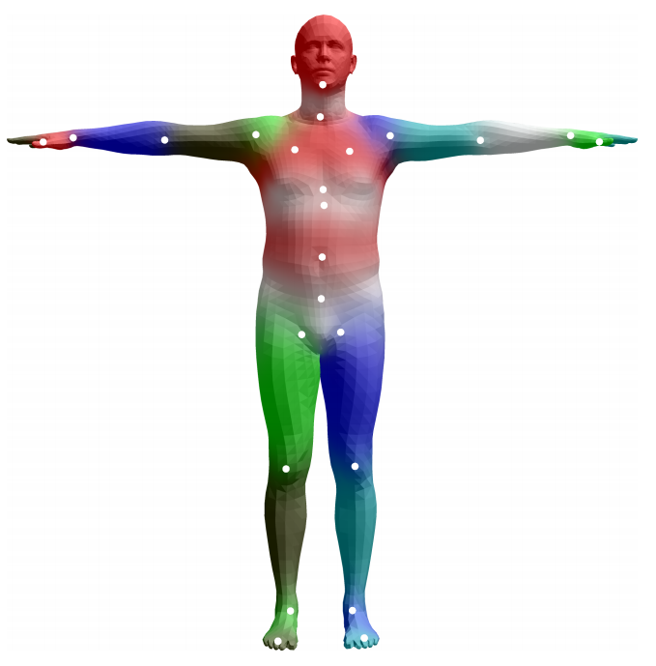
Parameters
Pose, Shape, Soft tissue displacements, Appearance
Shape Parameters - a shape vector of 10 scalar values, each of which could be interpreted as an amount of expansion/shrink of a human subject along some direction such as taller or shorter.
Pose Parameters - a pose vector of 24x3 scalar values that keeps the relative rotations of joints with respective to their parameters. Each rotation is encoded as a arbitrary 3D vector in axis-angle rotation representation.
Skinning - Each mesh vertex from the previous step is transformed by a weighted-combination of joint deformation. To put it simply, the closer to a vertex a joint is, the stronger the joint rotates/transforms the vertex.

Slide 9
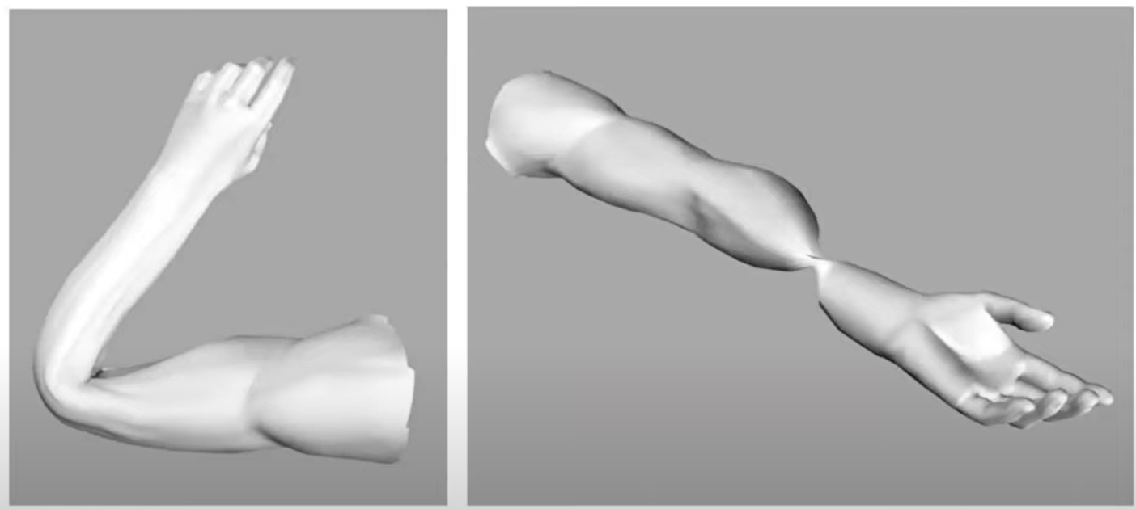
Collapse and Candy Wrapper

Slide 10
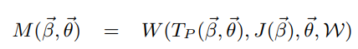
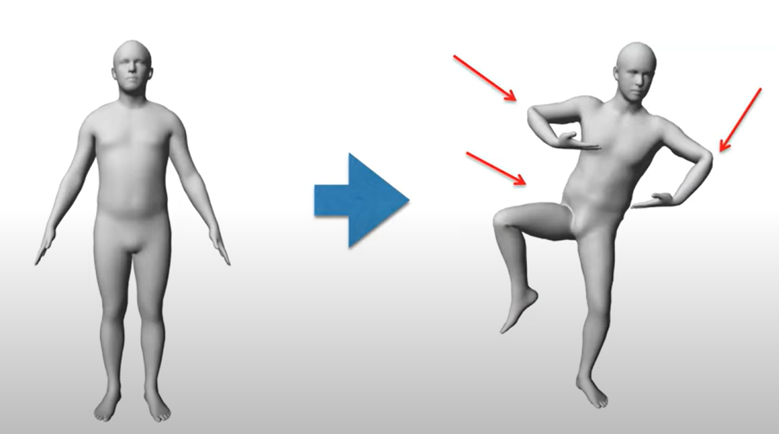
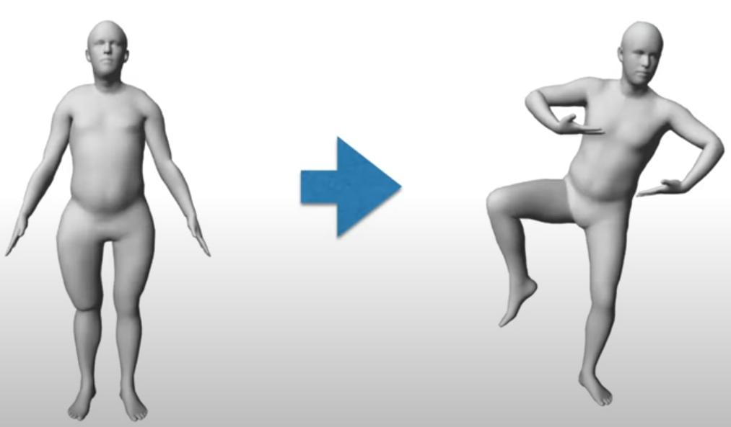
Solution

Slide 11
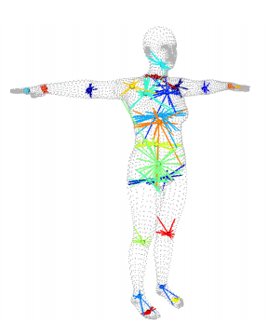
Joint Estimator
Each joint location could be estimated as an joint regression matrix of surrounding vertices.
Example:
Imagine the knee joint. The regression matrix would contain weights for the vertices near the knee. The joint's position is then calculated as a weighted average of these nearby vertices' coordinates.

Slide 12
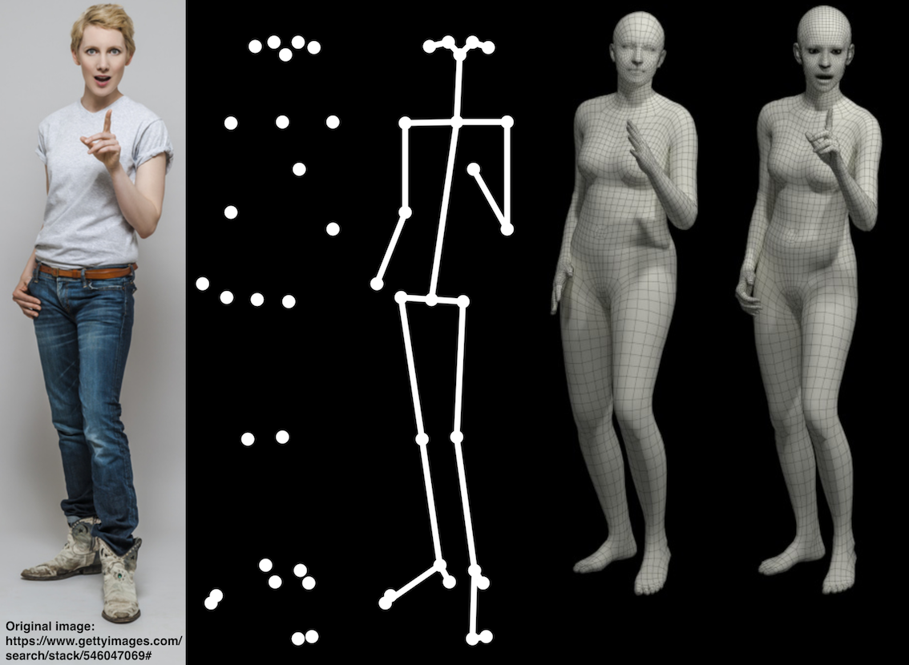
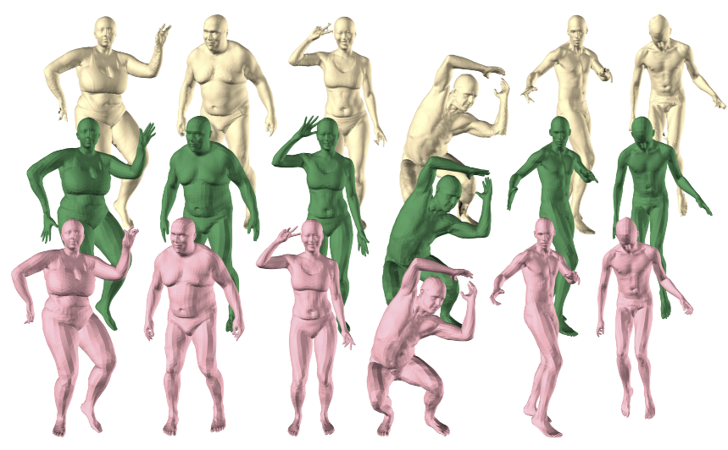
SMPL-H and SMPL-X
SMPL – 6890 vertices and 24 joints
SMPL-H – 8190 vertices and 54 joints
SMPL-X – 10475 vertices and 55 joints

Slide 13
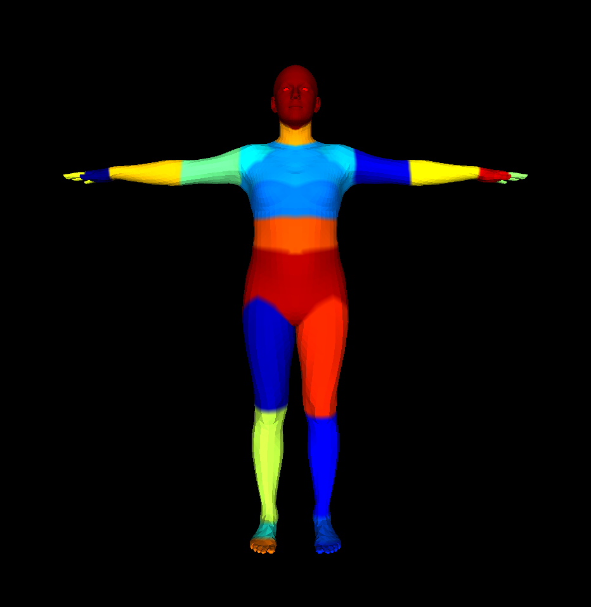
Part Segmentation

Slide 14
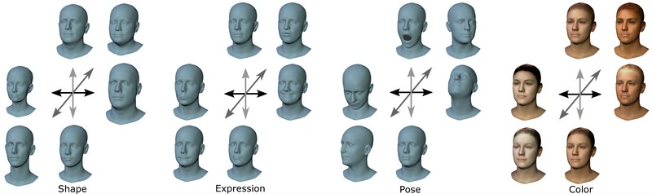
FLAME

Slide 15
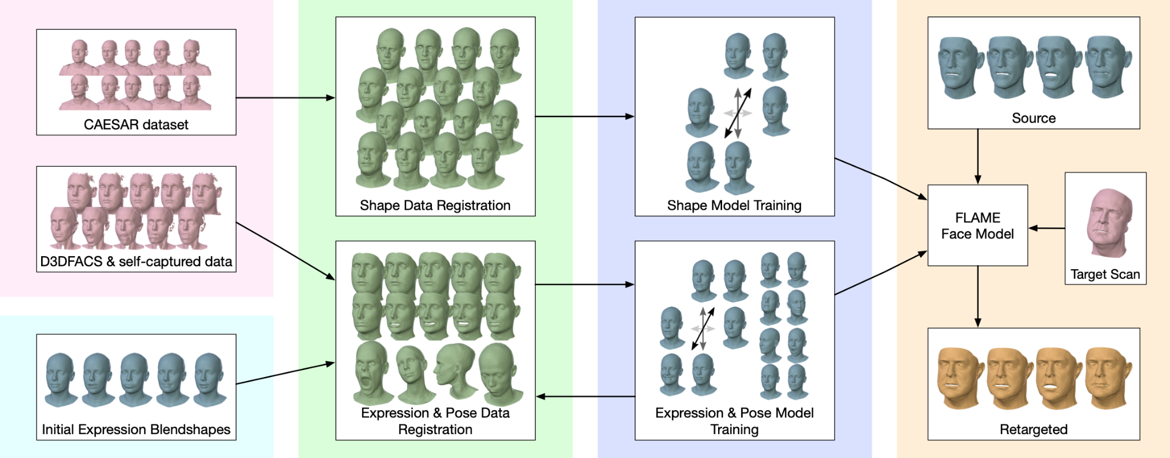
FLAME

Slide 16
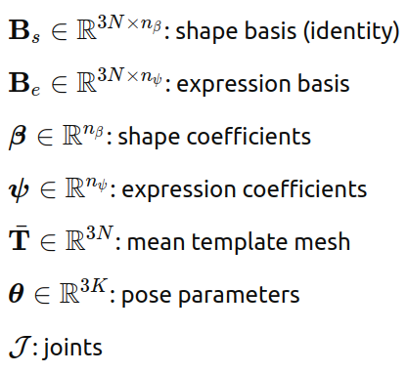
FLAME
Shape Blendshapes (Identity Parameters)
Number: 300 parameters
Purpose: Capture identity-specific facial variations
Usage: Linear combination weighted by shape parameters β
Expression Blendshapes
Number: 100 parameters
Purpose: Model facial expressions and emotional states
Usage: Linear combination weighted by expression parameters ψ
Li et al. (2017)

Slide 17
FLAME
Pose Blendshapes
Joints: 4 articulated joints + 1 global rotation
Left eye: Independent eye rotation
Right eye: Independent eye rotation
Neck: Head/neck articulation
Jaw: Jaw opening/closing and lateral movement
Global: Overall head pose (pitch, yaw, roll)
Representation: Axis-angle rotation vectors (3 parameters per joint)
Blend Skinning: W(T, θ, J, W) rotates vertices around joints J ∈ R^3K
Smoothing: Linearly blended using skinning weights W ∈ R^(K×N)
Usage: Each joint rotation affects nearby vertices with smooth falloff based on learned blend weights
Li et al. (2017)

Slide 18
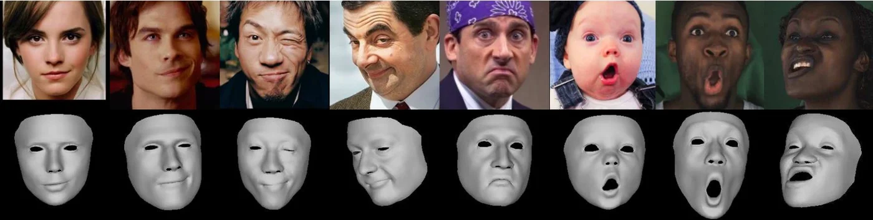
SMIRK: 3D Facial Expressions through Analysis-by-Neural-Synthesis
SMIRK is a method for 3D face reconstruction that excels at capturing subtle, extreme, asymmetric, and rarely observed facial expressions from single images.
Predictions:
Shape parameters (β): Identity-specific FLAME shape coefficients
Expression parameters (ψ): FLAME expression parameters, extended with two blendshapes for eye closure, plus jaw rotation parameters
Pose parameters (θ): Rigid pose and orthographic camera parameters

Slide 19
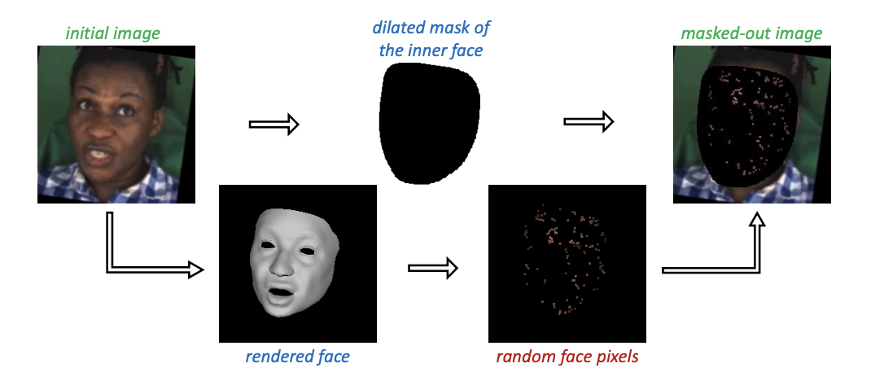
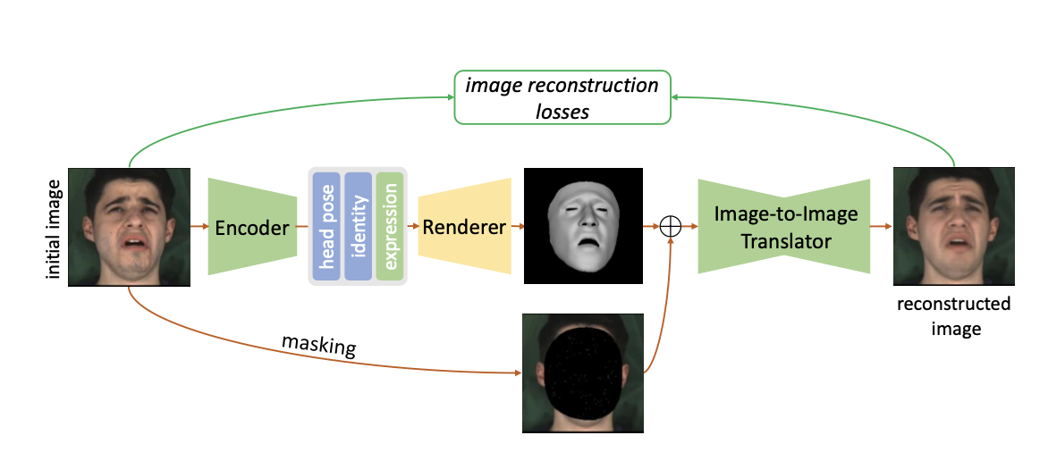
Neural Renderer (T)
Aims to replace traditional rendering using an image-to-image network.
Inputs to T:
S = R(θ, β, ψ): Monochrome render of predicted 3D face mesh
M(I): Masked input image (face masked, few random pixels retained)
Concatenation & Output:
I′ = T(S ⊕ M(I)) (⊕ = channel-wise concatenation) → T reconstructs the image using geometry & sparse image info.
Architecture:
U-Net is used for T → Enables strong gradient flow back to encoder E → Improves learning of facial geometry

Slide 20
Reconstruction Loss
Photometric Loss
Simple pixel-wise L1 loss between input and reconstructed image L_photo = ||I′ − I||₁
VGG Perceptual Loss
Uses deep features from a VGG network
Helps faster convergence early in training L_vgg = ||Γ(I′) − Γ(I)||₁
Landmark Loss
L2 distance between 2D facial landmarks in input and predicted mesh L_lmk = Σᵢ ||kᵢ − kᵢ′||²
Expression Regularization
Prevents weird/unrealistic expressions L_reg = ||ψ||²
Emotion Loss
Makes sure the emotion is preserved
Uses pretrained emotion model Pe L_emo = ||Pe(I′) − Pe(I)||²
Note: Only expression encoder E_ψ is updated; image translator T is frozen here.

Slide 21
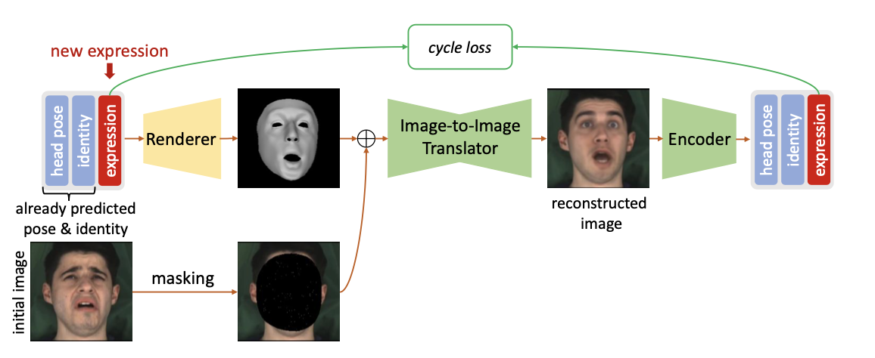
Augmented Expression Cycle Path
Problem: Even with strong reconstruction, rare or complex expressions (like unusual lip shapes) are hard to capture. This causes:
Expression collapse (distinct expressions look the same)
Translator T overcompensates for encoder mistakes
Solution: Expression Cycle Consistency
Start with predicted params: β, θ, ψ
Replace expression ψ with a new one: ψ_aug
Generate image: I'_aug = T(S ⊕ M(I_aug))
Re-encode I'_aug using E
Apply Cycle Loss: L_cycle = ||ψ_rec − ψ_aug||²
Promotes more diverse, distinct expressions
Avoids mixing up shape, pose, and expression

